Slide 1
Shell Bootcamp 2024 3 Reflections for Week #1
Harshika Sofat
Date : 30-Aug-2024

Slide 2

About Me
There is no easy way. Everything requires hardwork.

Slide 3

My learnings from this week!

Slide 4
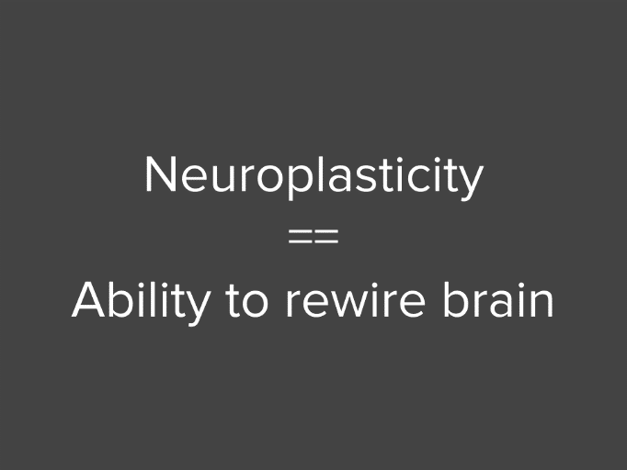
Learning 1 | My takeaways
SOFT SKILLS DAY 1 :
NEUROPLASTICITY – THE POWER OF PRACTICE MOLDS THE BRAIN
CART ANALOGY – SPECIFYING DIFFERENT TYPES OF PERFORMERS IN A TEAM
POWER TECHNIQUE – TO WRITE EMAILS
PRESENTATION SKILLS
IMPORTANCE OF TEAMWORK
SELF-IMPORTANT LESSONS

Slide 5

Learning 2 | My takeaways
SOFT SKILLS LEARNINGS (DAY 2 AND 3):
STAKE HOLDER MANAGEMENT GRID:
MANAGE AND COLLABORATE – HIGH POWER AND HIGH INTEREST
SATISFY – HIGH POWER AND LOW INTEREST
INFORM – LOW POWER AND HIGH INTEREST
MONITOR – LOW POWER AND LOW INTEREST

Slide 6
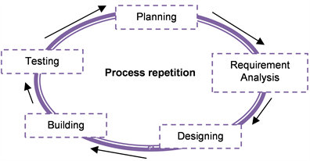
Learning 3 | My takeaways
TECHNICAL SKILLS LEARNINGS (DAY 1 & 2):
ROLE OF BUSINESS ANALYST/PRODUCT OWNER
MAKING OF SRS(SYSTEM REQUIREMENT SPECIFICATIONS) AND BRD (BUSINESS REQUIREMENT DOCUMENT)
SDLC MODELS- WATERFALL MODEL, V MODEL, PROTOTYPING MODEL–ADV/DISADV
AGILE MODEL- EPICS, USER STORIES, SCRUM MASTER, BURNDOWN CHARTS, DIFF. TYPES OF MEETINGS

Slide 7

Relevance of learnings for my organization

Slide 8

Learning 1 | Relevance for Shell
Activities like making presentations together and presenting them helped us learn team work and also helped us understand how crisp yet detailed the ppt should be. Presenting the ppt infront of the class gave the confidence for future presentations.
The power technique helped us understand how to frame mails in the correct order, avoiding the commonly done mistakes by other employees.

Slide 9

Learning 2 | Relevance for Shell
Stakeholder management is essentially important to be able to understand business better. It helps me to understand the difference between internal and external stakeholders. The activities involved along with the theory helped with building a better foundation for the overall topic.
[Add a graphic that provides view of how Shell implements this learning]

Slide 10
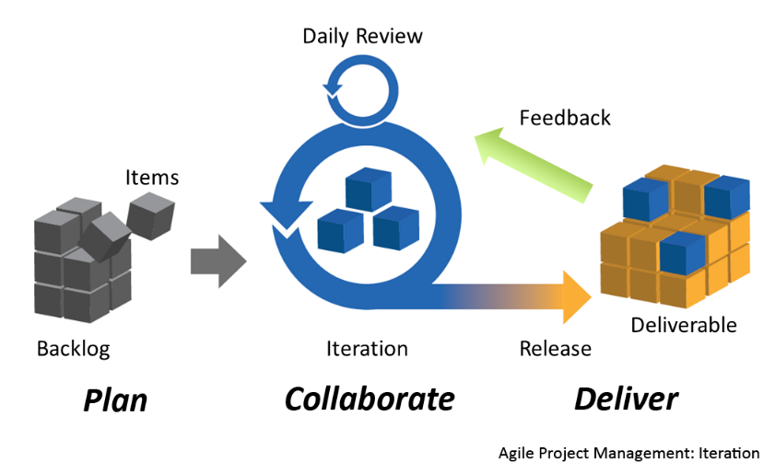
Learning 3 | Relevance for Shell
I will be able to understand how the product owner makes the various srs and brd documents and how they should be read.
I understood the various models used previously and their advantages and disadvantages.
I learnt the current applications of the agile model and the various components in it. The various types of meetings held in between and during the start and end of the sprints. How each decision is taken during a sprint. The uses of user stories for developers, and burndown charts to calculate amount of work done against the number of days passed.
[Add a graphic that provides view of how Shell implements this learning]

Slide 11

Challenges in implementing learning

Slide 12

Challenge faced while implementing Learning 1
Initially everyone was shy and scared and were very skeptical in answering in the class or to share their thoughts. But due to the fun activities and supporting teacher we were able to overcome our shyness and participate in the activities
[Add a graphic that provides evidence of what you did to overcome this challenge]

Slide 13

Challenge faced while implementing Learning 2
Stakeholder management looked like a difficult topic at first with a lot of theory. But eventually the activities made it easier to understand.
[Add a graphic that provides evidence of what you did to overcome this challenge]

Slide 14

Challenge faced while implementing Learning 3
Though SDLC Models were already taught to us in the college, but it was a good recap. The role of BA and agile model had a lot of theory but were very interesting to learn.

Slide 15

Action Plan

Slide 16
My Action Plan for this Week
Actions
Timeline
Status
Going through all the concepts in class once again using notes to make sure I have no doubts going further.
Saturday & Sunday – revise over all the topics
Status of the same by the end of the week

Slide 17

Learning is also Fun!

Slide 18

Learning is also Fun!
We had an activity where each team was given a scenario and we had to do a small roleplay using our own creative ideas. Initially everyone was shy, but the some teams really performed well and added a factor of fun and humour in the environment.
team enjoyed the new learning]

Slide 19

Summary
Soft skills training – power technique, neuroplasticity, team work, stake holder management
Technical skills training – role of business analyst, sdlc models, agile model in detail.
Expected to have more technical training on technical topics in upcoming week.

Slide 20
Thank You

